Slide 1
IoT Based Gas Leakage Detection and Alarming
System using Blynk platforms
Group 22
Md. Asiful Islam
17201077
Mahmudul Hasan Mitul
18101066
Mahedi Hasan Shanto
18301185

Slide 2
Introduction
Worldwide use of LPG Gas
Safety concern occurs
Using an ESP2866 wifi microcontroller and an IOS IoT application, the suggested system will monitor the surroundings for any leakage detection.
Notify the user of the location's gas level due to environmental circumstances
Blynk notification is used for installation.
01

Slide 3


02
Literature review
.
Gives a cloud based solution.
Focus on minimizing hamper
Focus on modifying the system

Slide 4
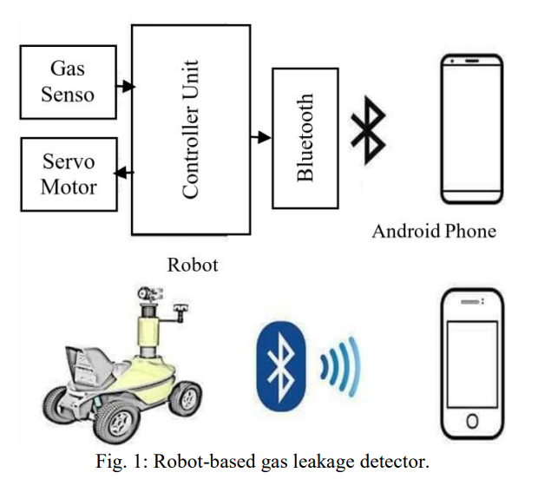
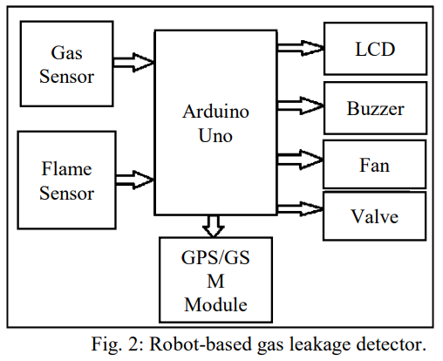
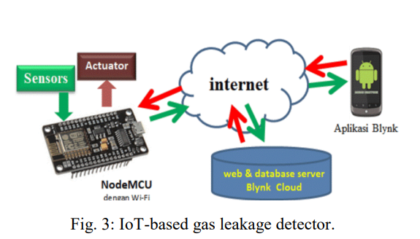
GAS LEAKAGE DETECTION TECHNIQUES
Robots-based gas leakage detector:
GSM-based gas leakage detector:
IoT-based gas leakage detector:
03

Slide 5
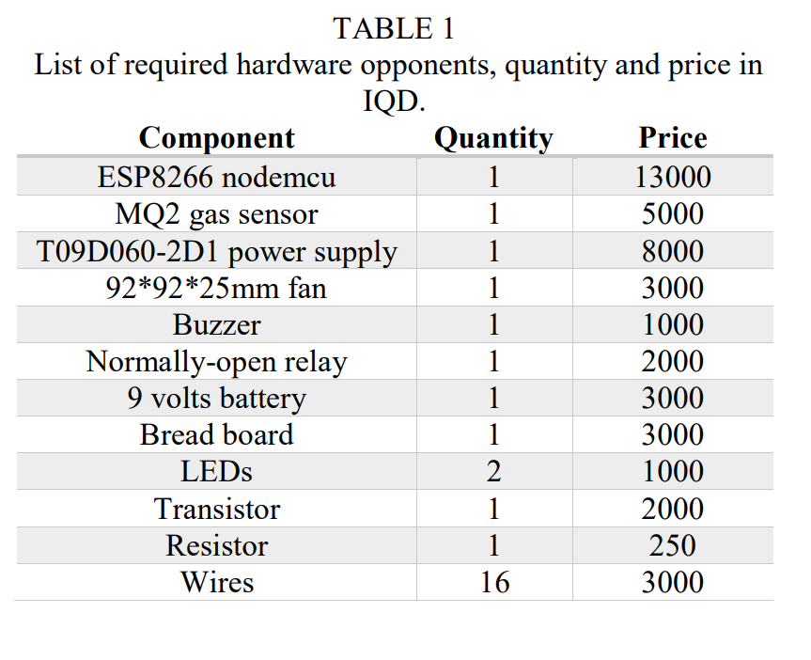
System Components
Gas Sensor MQ-2
Wi-Fi Node MCU ESP8266
Fan
Power Supply 9V
Buzzer
Relay
Buttery 3.3v to 5v
red LED and green LED
Transistor B514
Breadboard
200 ohms resistors
04
Hardware components for blynk application:

Slide 6
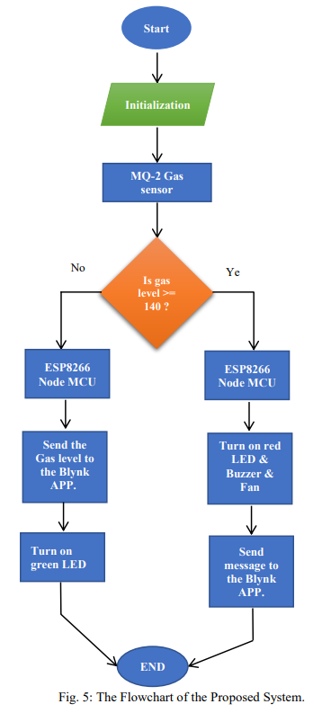
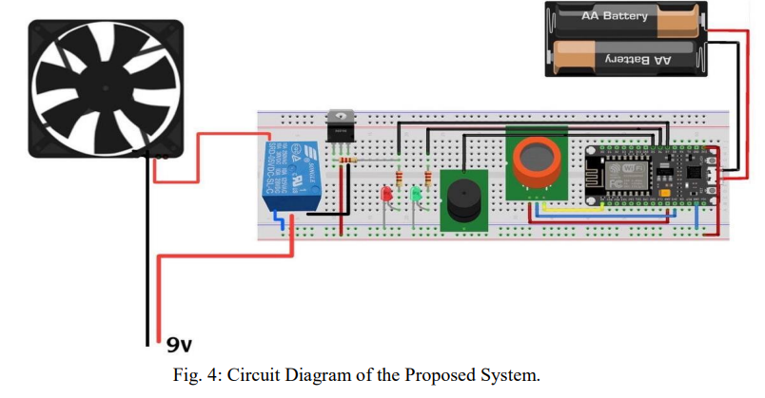
Methodology
When a gas leak is detected by a MQ-2 gas sensor, data is sent to the controller (ESP8266) through the controller analog port (A0). (Fig 4)
The controller (ESP8266) will then send a warning text message
Simultaneously, the buzzer will be activated for alert purposes
A transistor functions as a switch that turns on and off low loads.
When the circuit is closed - when the red LED is on - the relay turns on and off high loads, with the high load performing the fan. (Fig 5)
05

Slide 7
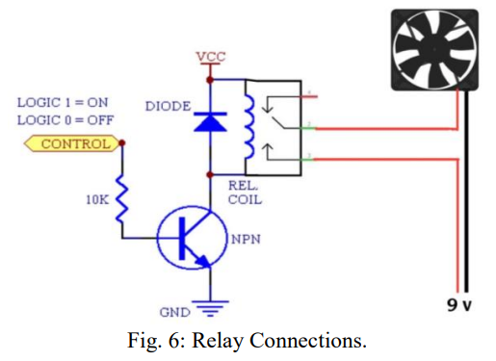
WORKING PRINCIPLES
Blynk Platform
The Blynk application
The Blynk server
The Blynk libraries
Proposed System Operations
Two power source
Transformer
Rechargeable battery
06

Slide 8
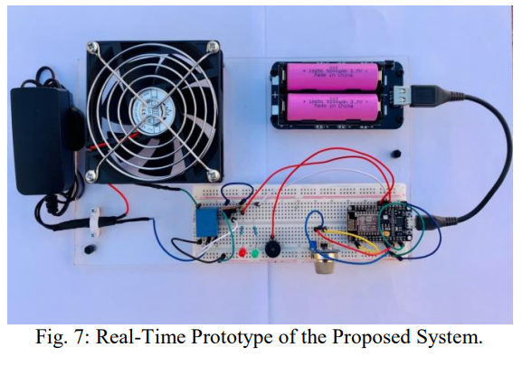
REAL TIME PROTOTYPE
07
In gas leakage sensor will send signal
Warning message to the phone

Slide 9
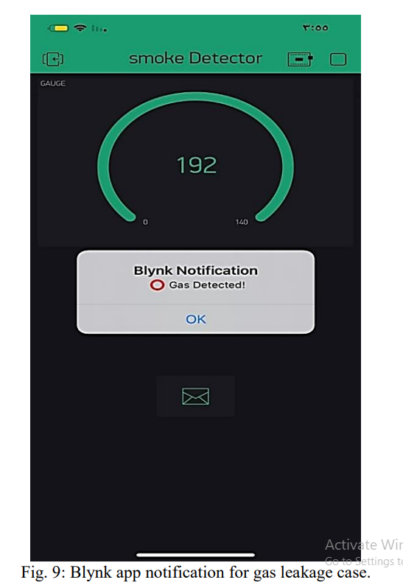
BLYNK’S IOT PLATFORM RESULTS
08
Amount of gas leakage that the sensor detects
IOT to record the readings

Slide 10
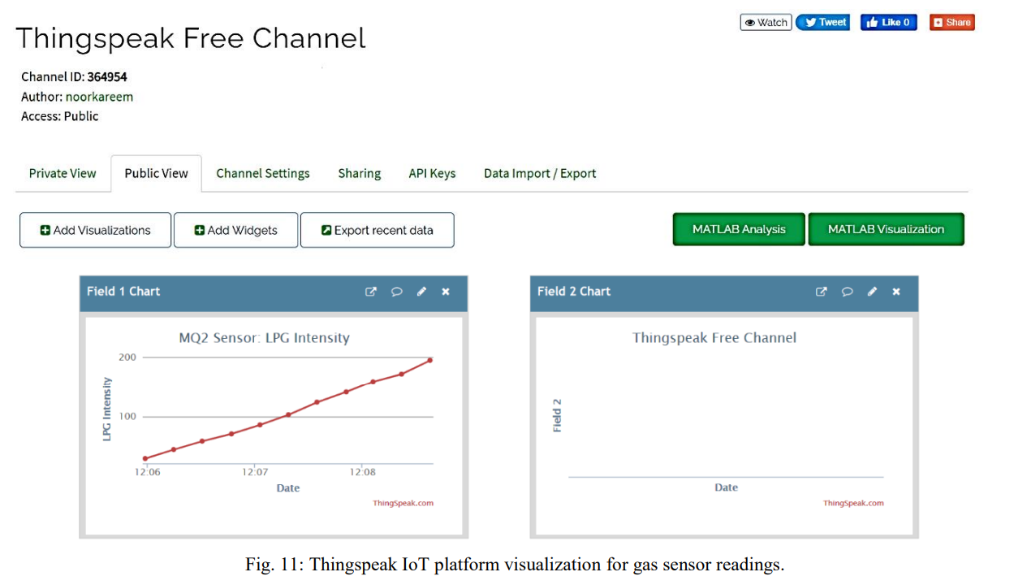
09

Slide 11
10
Conclusion
Efficiency of the node MCU.
Using Blynk because faster than other IOT platforms.
Easy control over exhaust fans.

